Slide 1
Tech Selector
Iteration 4 Class & Sequence Diagrams

Slide 2
Class Diagrams

Slide 3
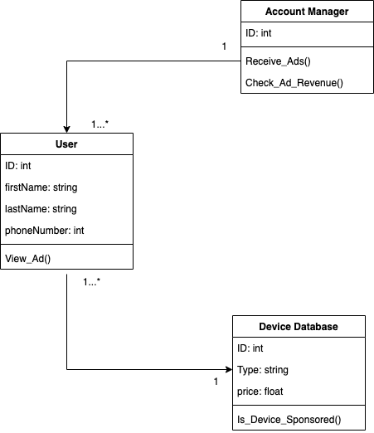
03.04 Advertisement Payment and Discount

Slide 4

04.02 Question to Query Conversion

Slide 5
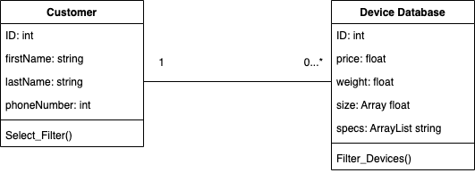
05.02 Showing Recommended Devices

Slide 6
Sequence Diagrams

Slide 7
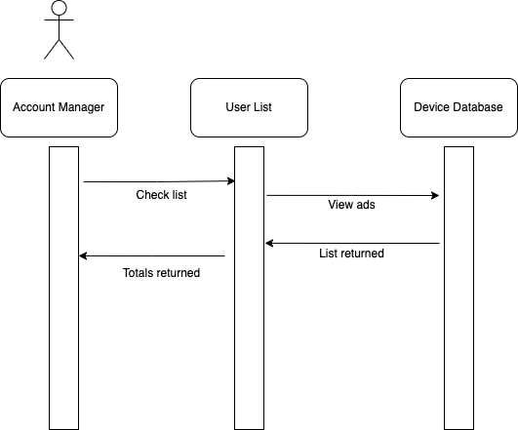
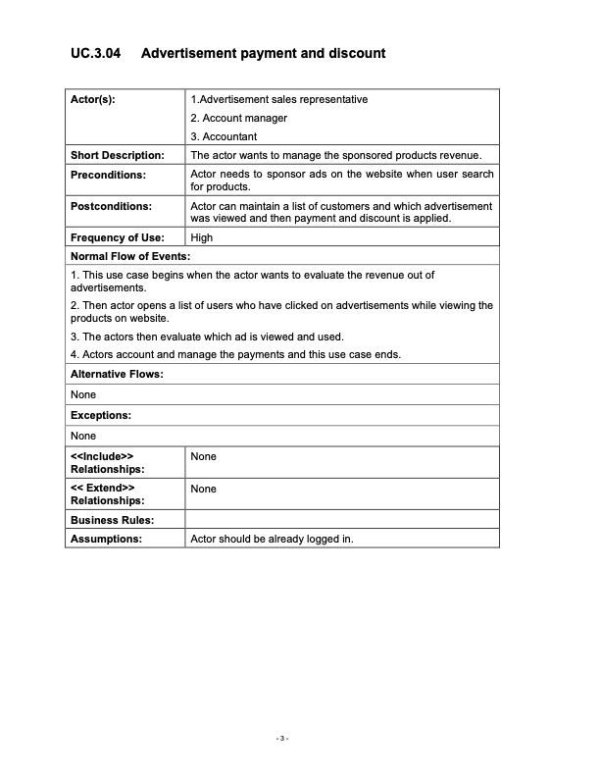
03.04 Advertisement Payment and Discount

Slide 8
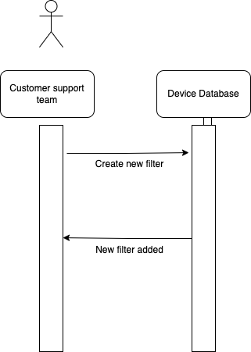
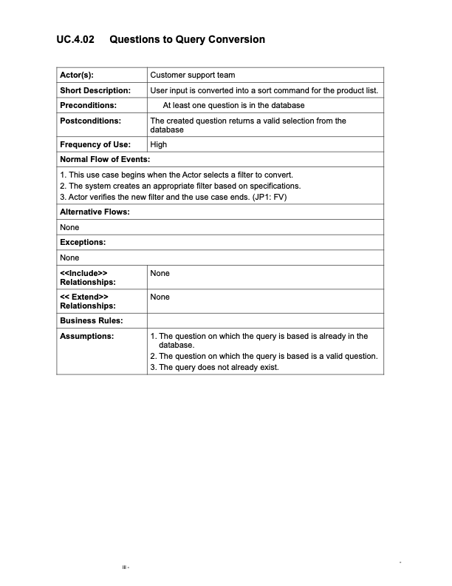
04.02 Question to Query Conversion

Slide 9
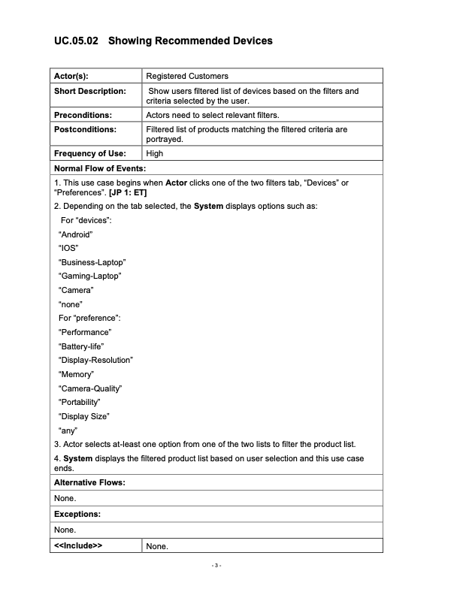
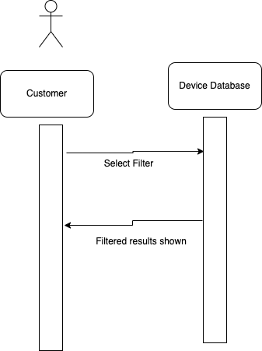
05.02 Showing Recommended Devices

